Slide 1
The Economy of Digital Jobs
Chad Qian

Slide 2
Background
Formal labor vs. On-demand labor
On-demand crowdsourced labor (“crowd work”):
Lower barriers to entry, but lower pay
More flexible labor, but worse quality control

Slide 3
Types of On-demand Platforms
 | Low-interaction | High-interaction
Low-skill
Medium-skill
High-skill

Slide 4
Types of On-demand Platforms
 | Low-interaction | High-interaction
Low-skill | MTurk, Cloudflower (“Crowd work”)
Medium-skill
High-skill

Slide 5
Types of On-demand Platforms
 | Low-interaction | High-interaction
Low-skill | MTurk, Cloudflower (“Crowd work”)
Medium-skill | TaskRabbit, Fiverr, Upwork (“Freelancing”)
High-skill

Slide 6
Types of On-demand Platforms
 | Low-interaction | High-interaction
Low-skill | MTurk, Cloudflower (“Crowd work”)
Medium-skill | TaskRabbit, Fiverr, Upwork (“Freelancing”)
High-skill | InnoCentive (“Outsourced R&D”)

Slide 7
Types of On-demand Platforms
 | Low-interaction | High-interaction
Low-skill | MTurk, Cloudflower (“Crowd work”) | SamaSource (Development “Crowd work”)
Medium-skill | TaskRabbit, Fiverr, Upwork (“Freelancing”)
High-skill | InnoCentive (“Outsourced R&D”)

Slide 8
Types of On-demand Platforms
 | Low-interaction | High-interaction
Low-skill | MTurk, Cloudflower (“Crowd work”) | SamaSource (Development “Crowd work”)
Medium-skill | TaskRabbit, Fiverr, Upwork (“Freelancing”) | No major platforms (A typical formal job)
High-skill | InnoCentive (“Outsourced R&D”) | No major platforms (A typical formal job)

Slide 9
Amazon Mechanical Turk (MTurk)
Launched in 2005
Image tagging, data transcription, etc.
Pennies per task

Slide 10
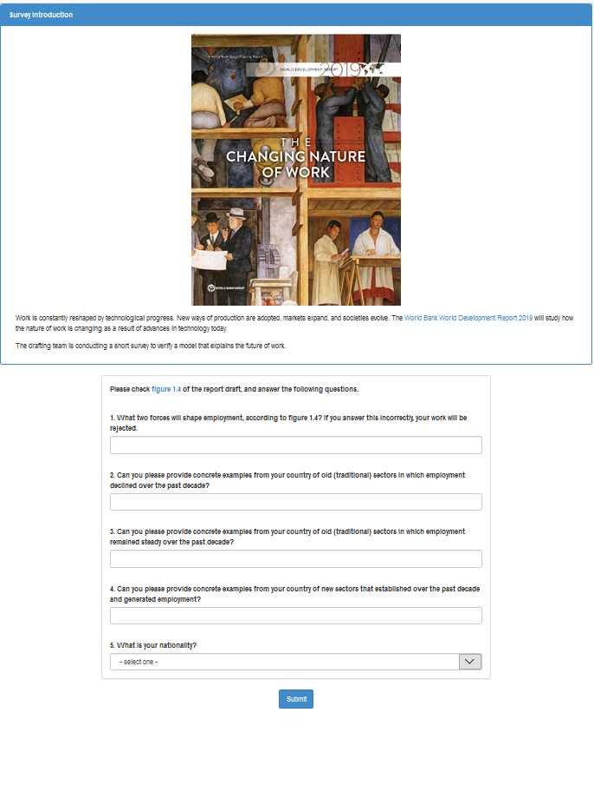
Surveys
Give feedback on WDR report
$0.15-0.18 per response
“Reading check”
Auto-rejector

Slide 11
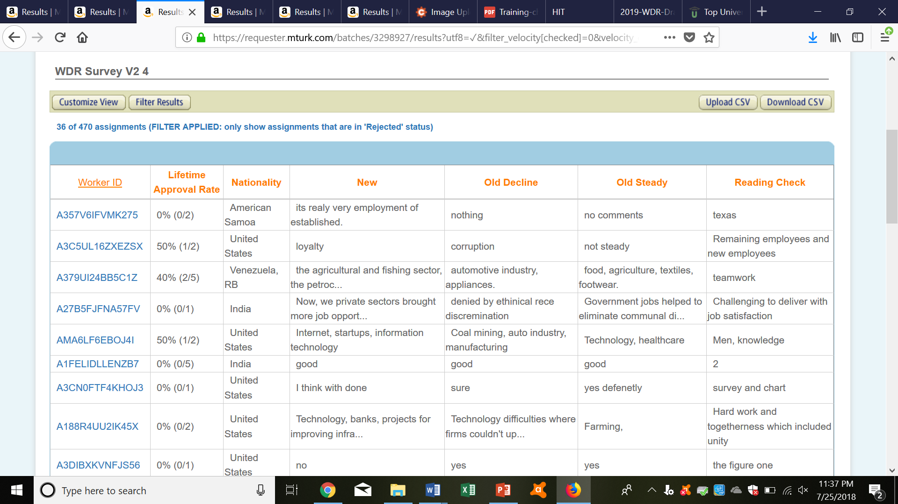
Surveys
3,000 responses for $500 in a month
Troll responses

Slide 12
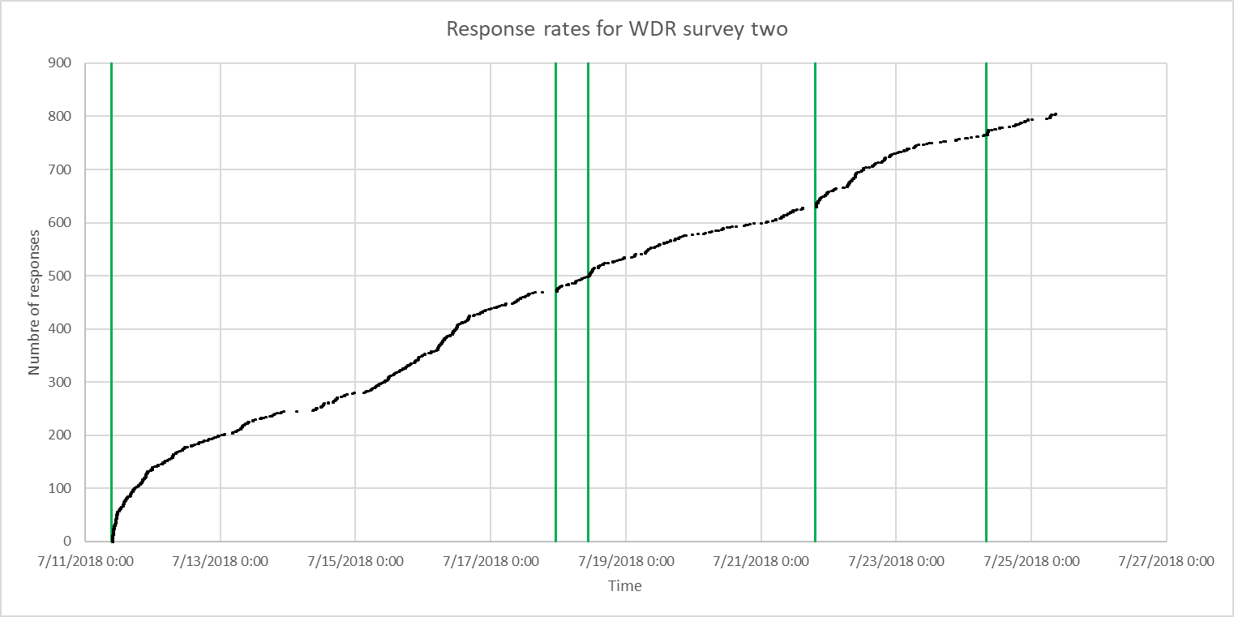
Surveys
Response rates?

Slide 13
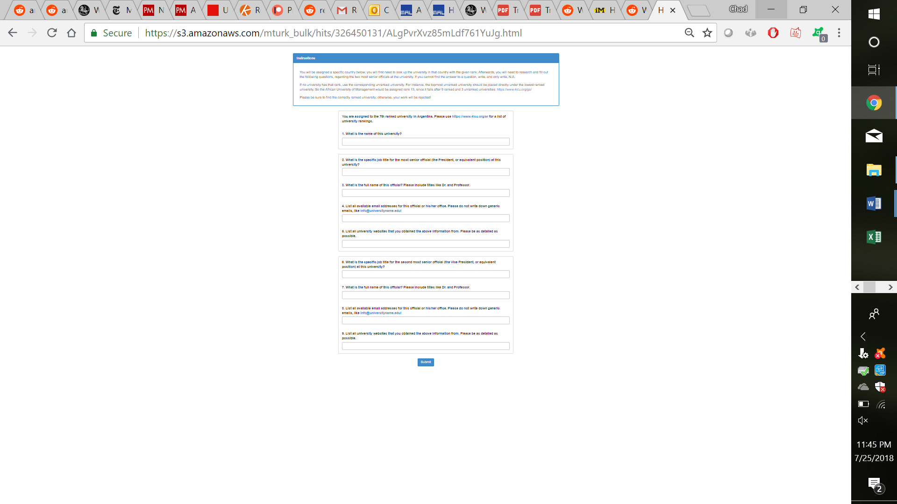
Online data collection
University emails
$0.10 - $0.15 per university
“Sanity check”
Three people (automatic)

Slide 14
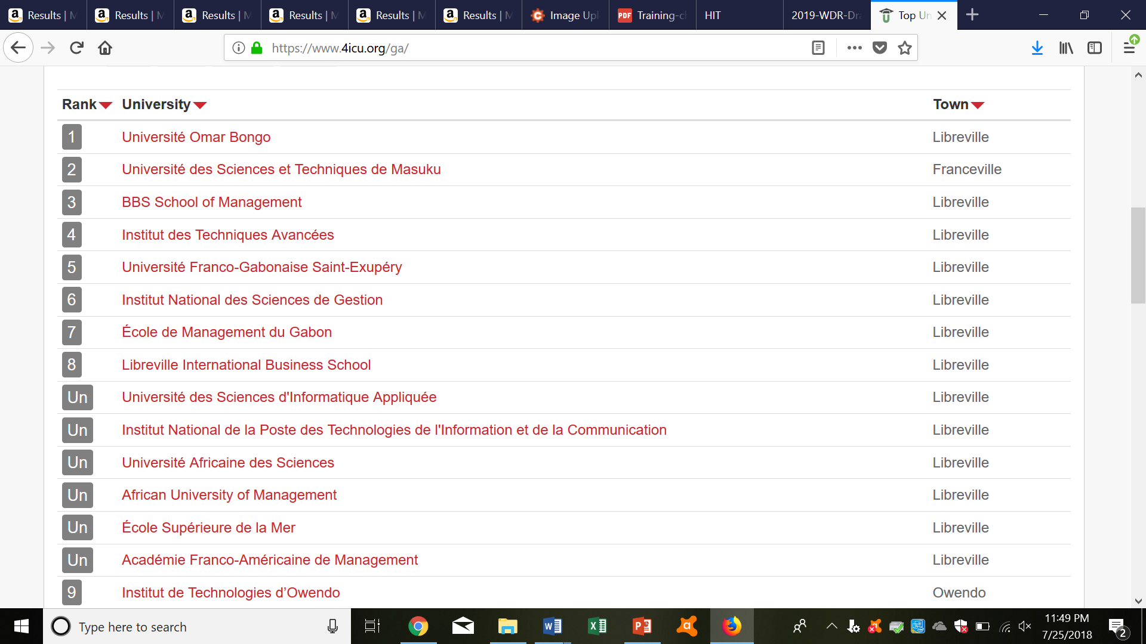
Online data collection
Finished for $850 in a week
Vague wording

Slide 15
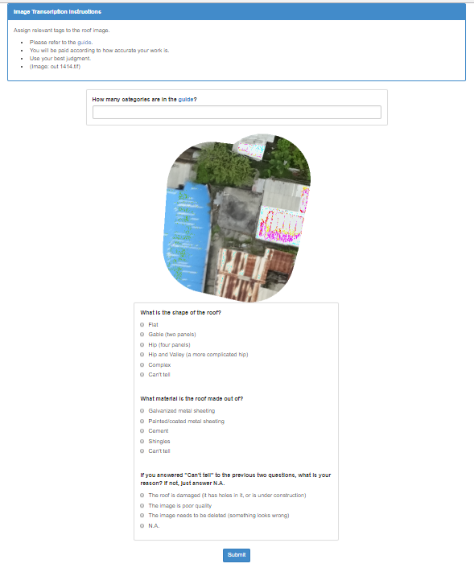
Image tagging
Tag roof images
$0.01 per image
“Reading check”
Three people (automatic)

Slide 16
Image tagging
Over 4,500 pictures tagged in less than 24 hours for less than $300
Social media snafu

Slide 17

Image tagging

Slide 18
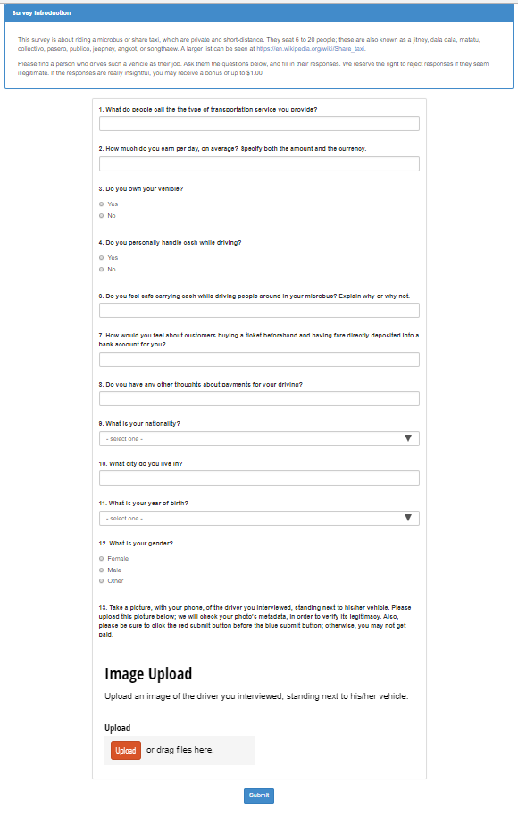
Field interviews
Interview microbus drivers
$5.00 per interview
“Sanity check”
Image upload

Slide 19
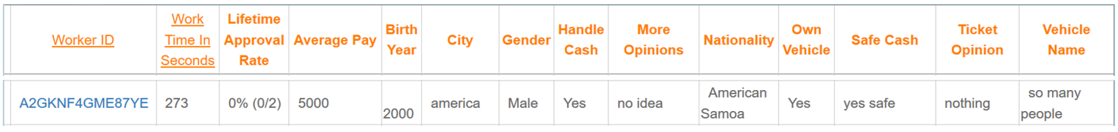
Field interviews
Nearly 100 responses in a week
Most bad…

Slide 20

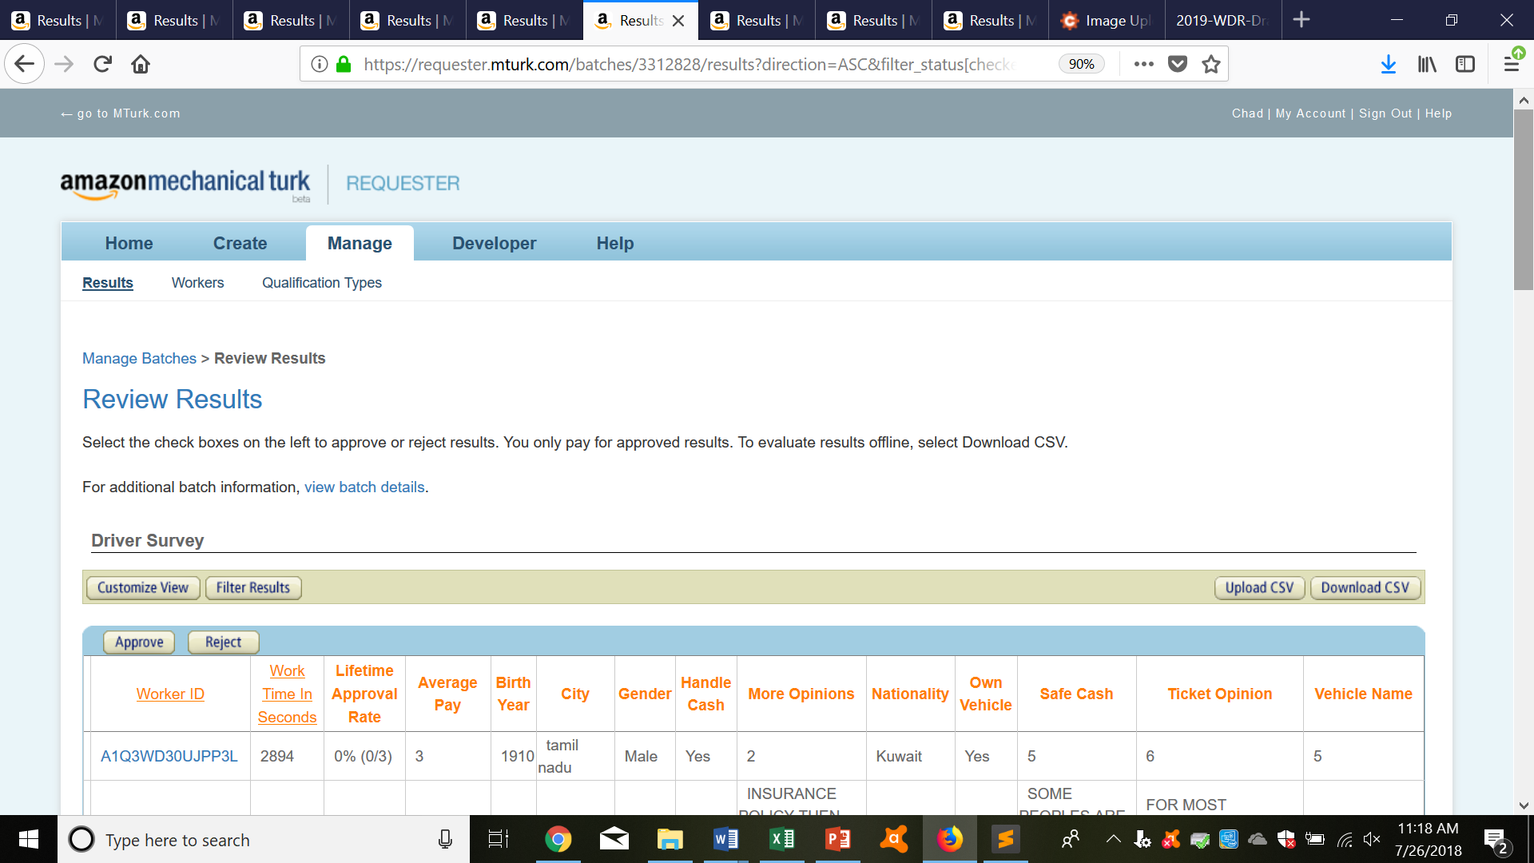
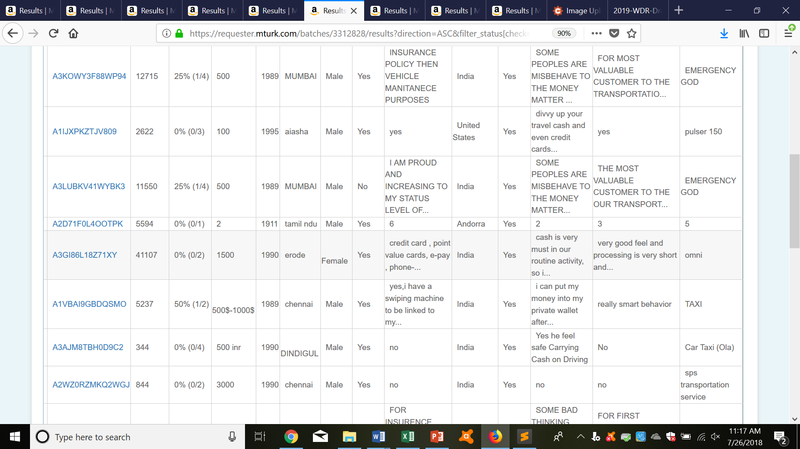
Field interviews
Troll

Slide 21
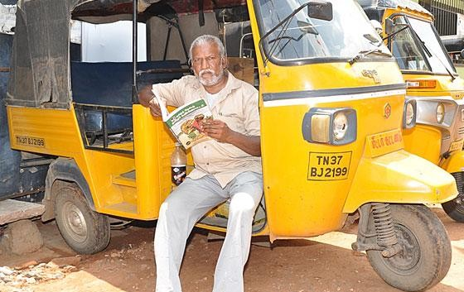
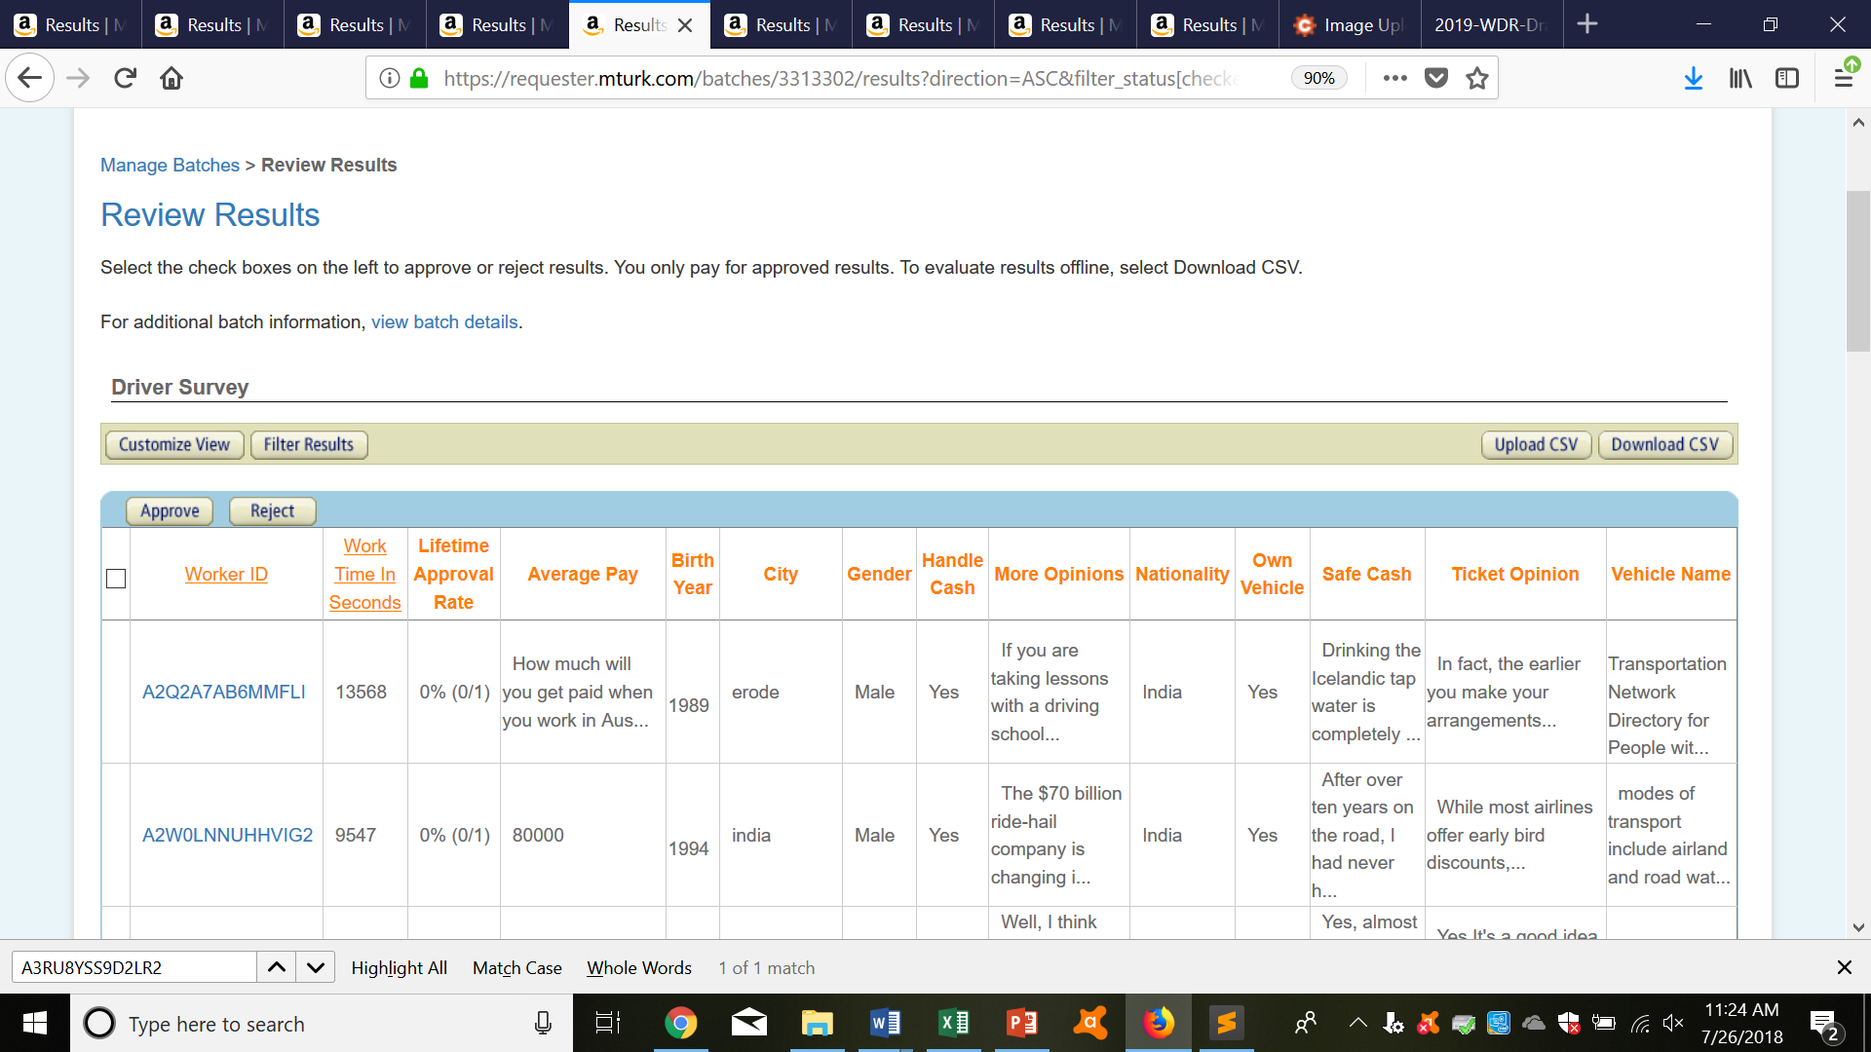
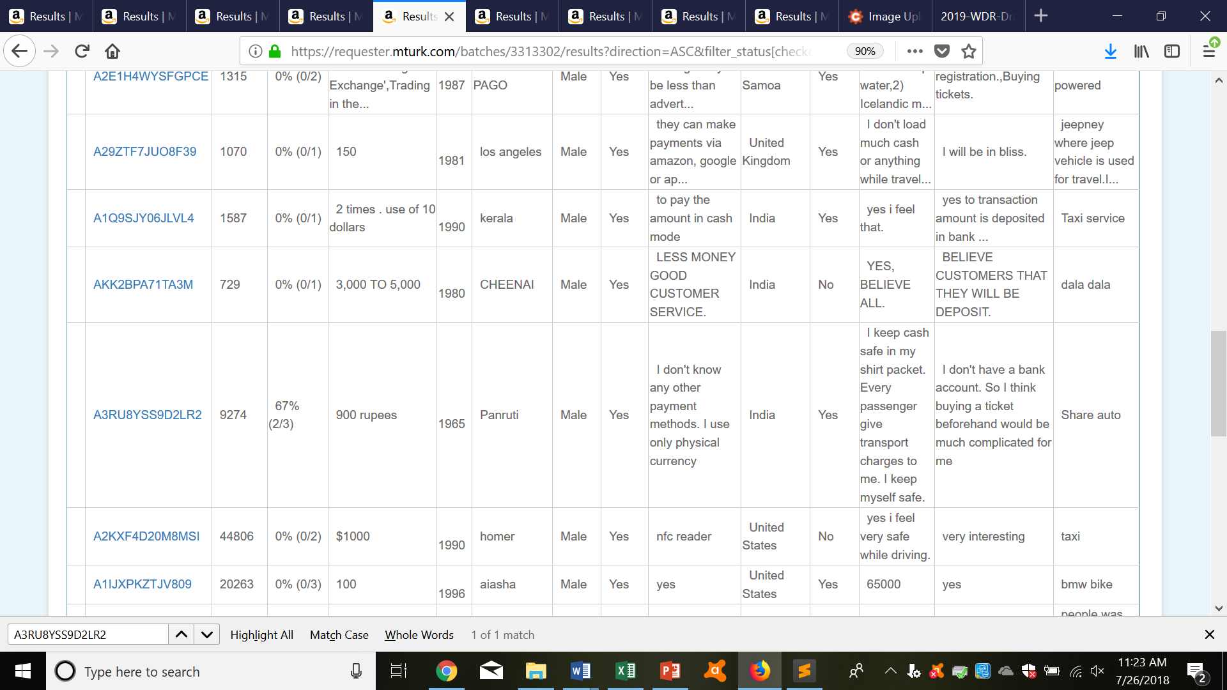
Field interviews
Fake

Slide 22
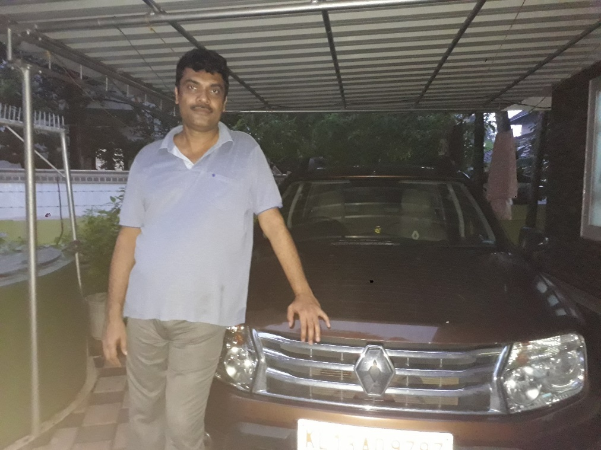
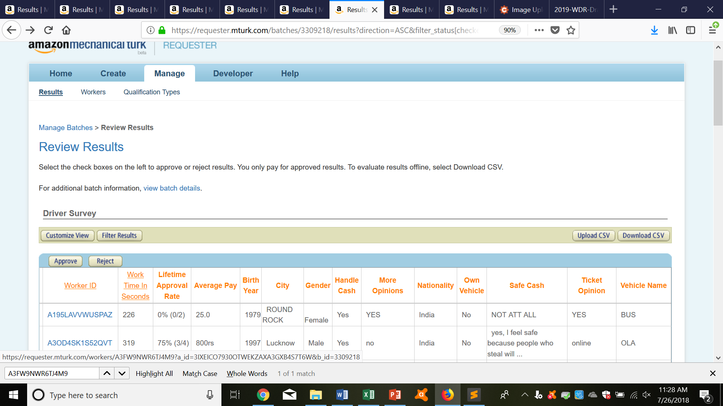
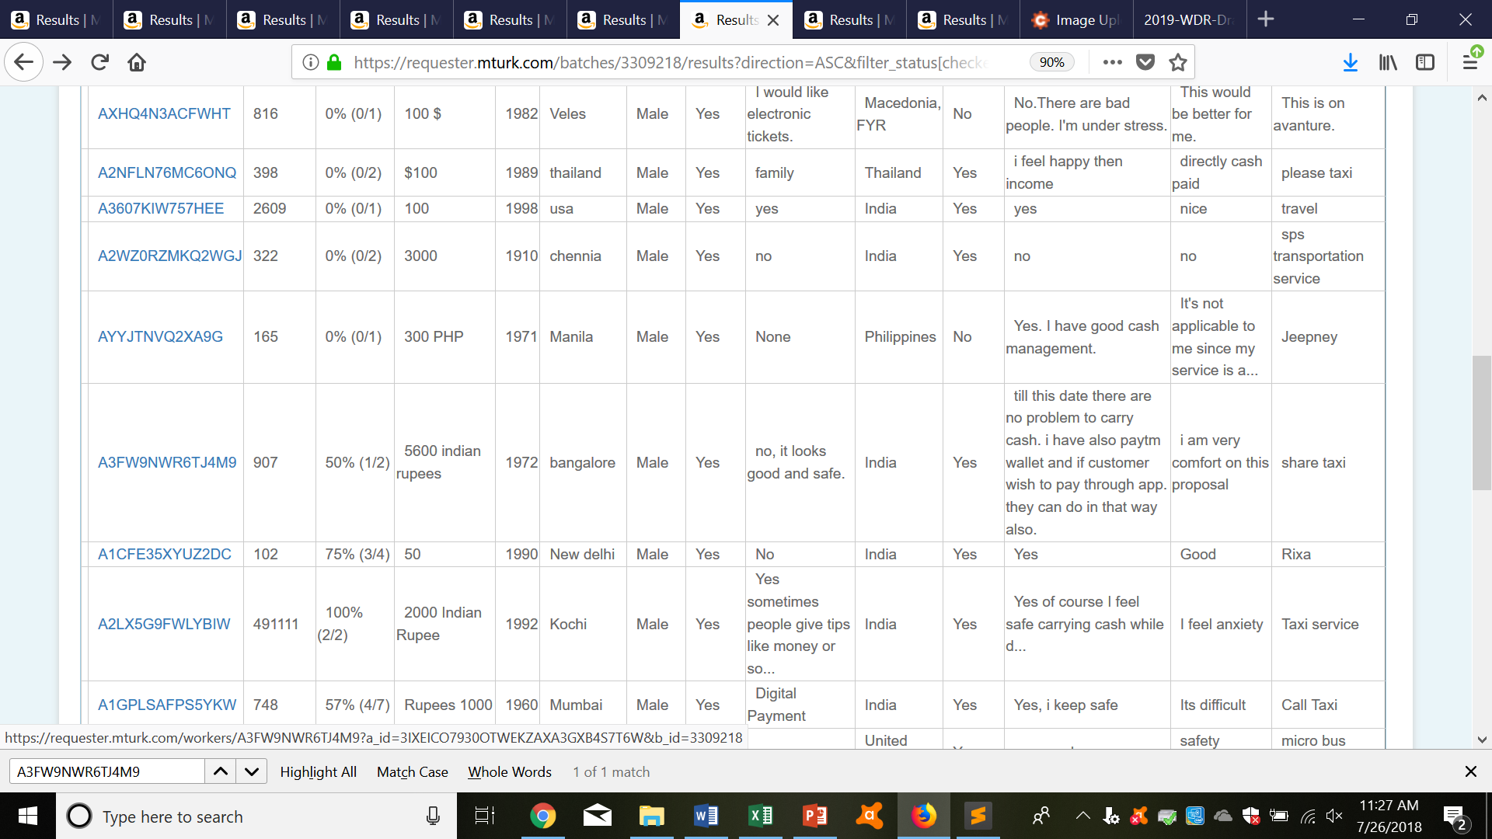
Field interviews
Irrelevant

Slide 23
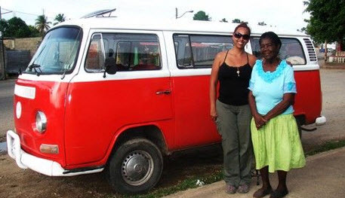
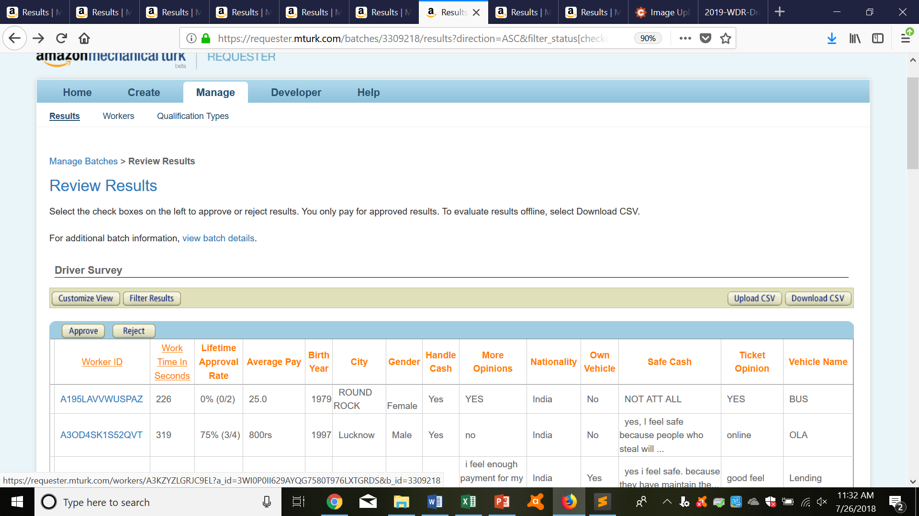
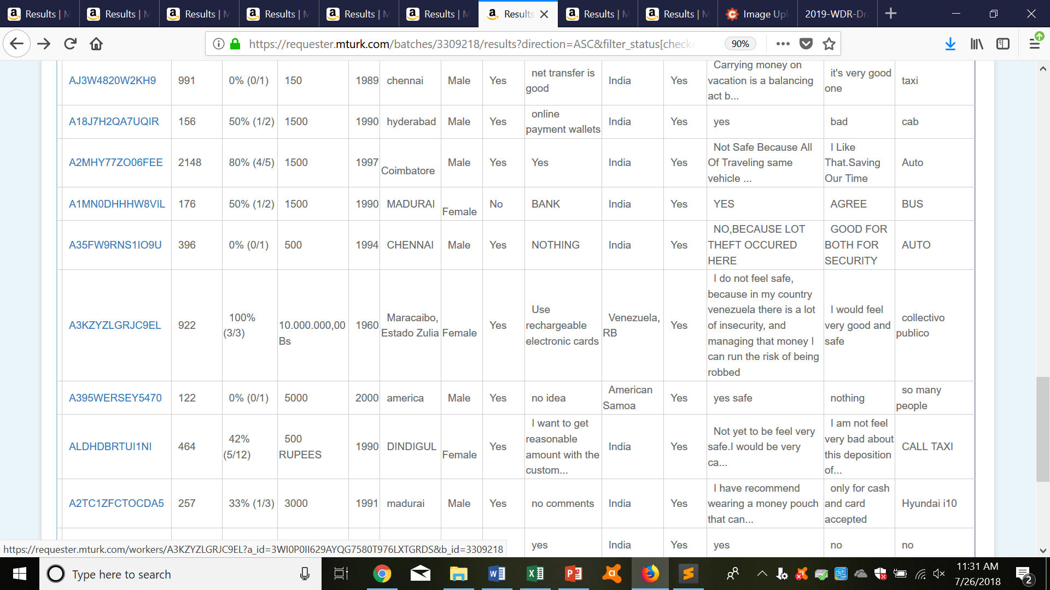
Field interviews
Old

Slide 24
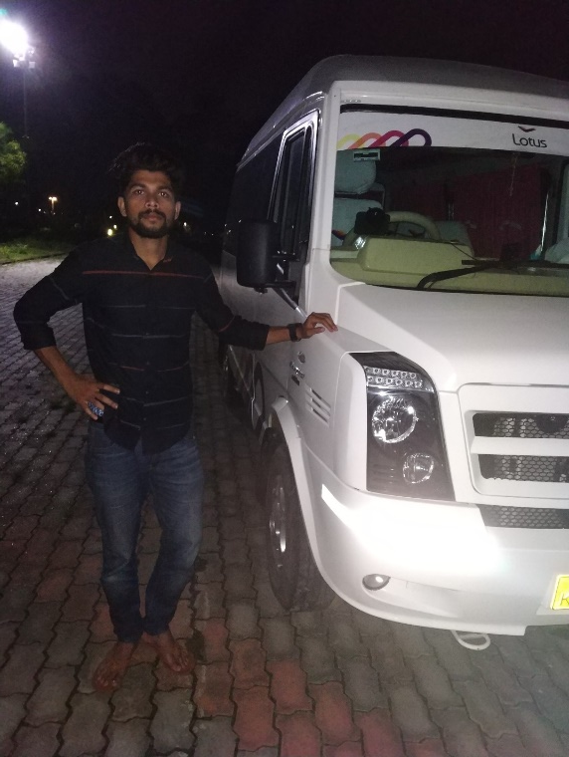
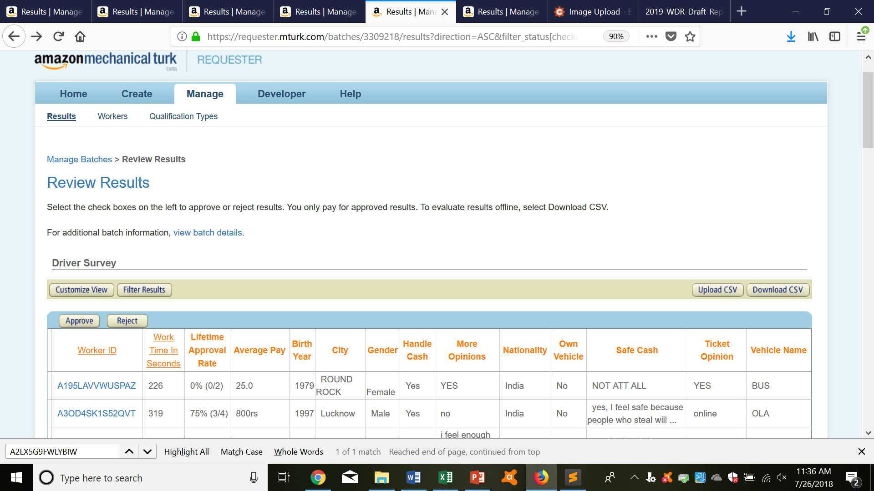
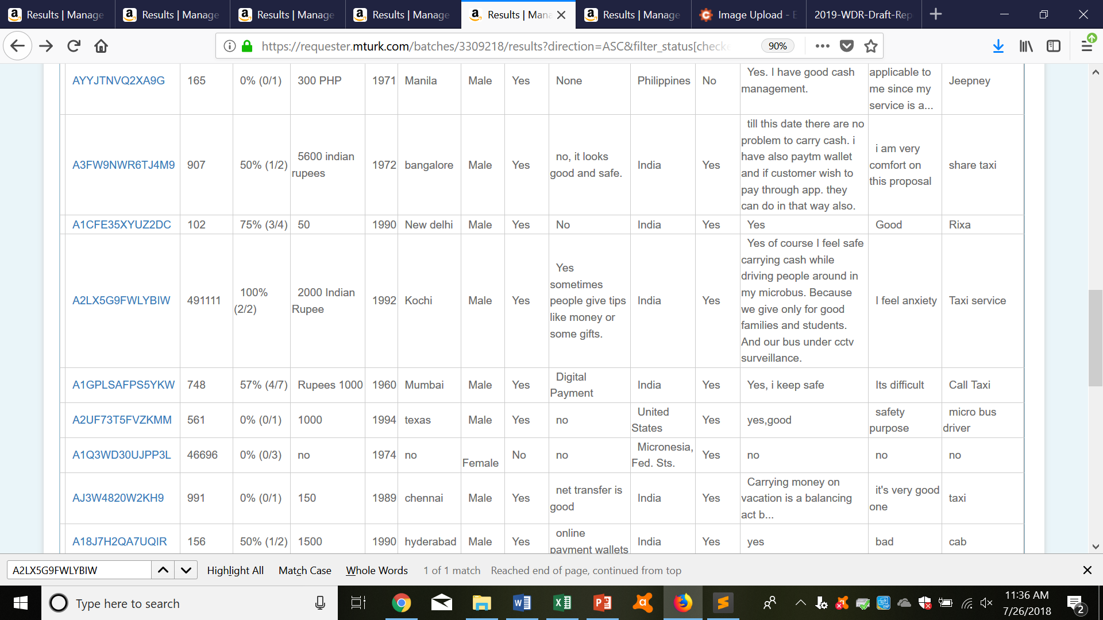
Field interviews
Good

Slide 25
Key Takeaways
Be clear.
Be generous.
Be careful.
Be prompt.

Slide 26
Future Work
MTurk’s open API
Custom, World Bank UI
Tasks:
Image tagging (good)
Surveys, Online data collection (maybe)
Field interviews (hard)

Slide 27
Further Reference
MTurk Guide
Python files on Github

